Slide 1


Software Quality Engineering
(Week-5)
Usama Musharaf
LECTURER (Department of Computer Science)
FAST-NUCES Peshawar

Slide 2
Content of Week # 5
Quality Attributes:
Reliability

Slide 3
Reliability

Slide 4
Reliability
    Software reliability is defined as the probability of failure-free operation of a software system for a specified time in a specified environment.

Slide 5
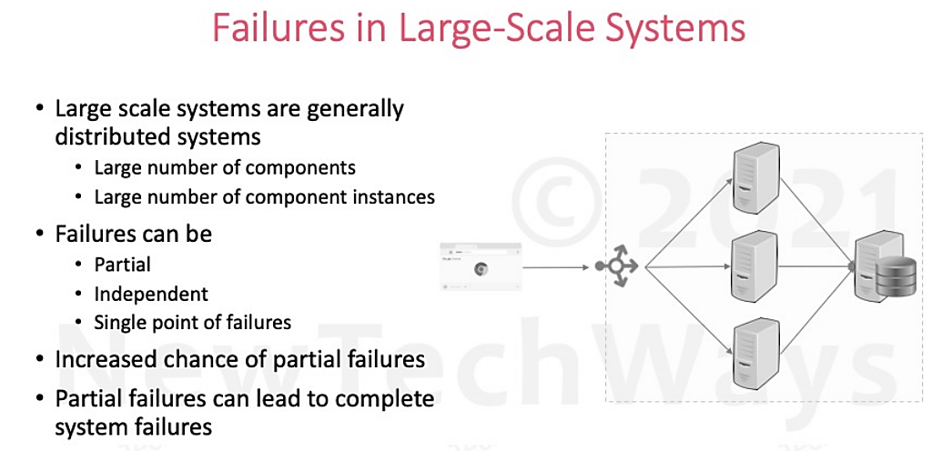

Slide 6
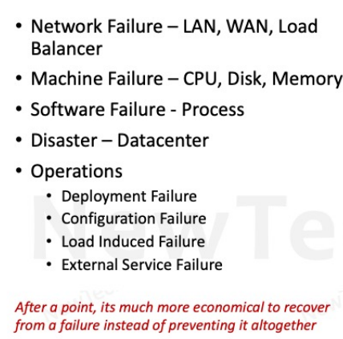
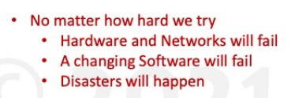
Partial Failures

Slide 7
Reliability Engineering
Reliability
Availability
Fault Tolerance

Slide 8
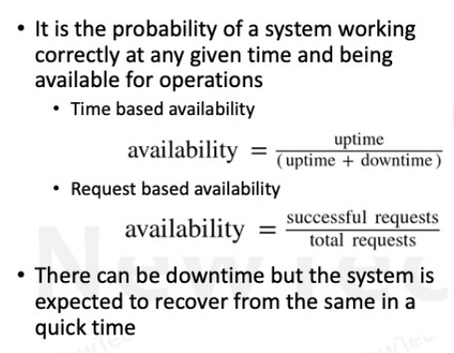
Availability

Slide 9
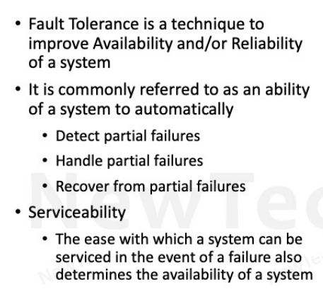
Fault Tolerance

Slide 10
Fault Tolerant Design
Redundancy
Fault Detection
Recovery

Slide 11
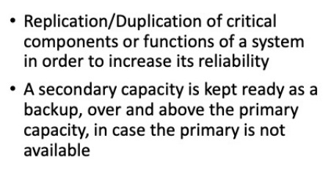
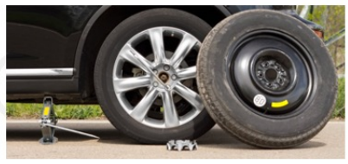
Redundancy

Slide 12
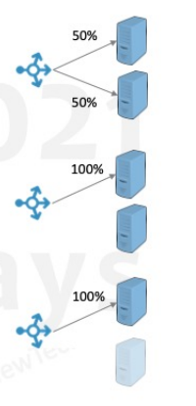
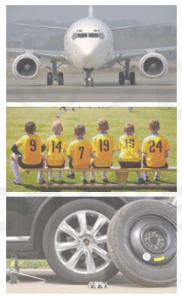
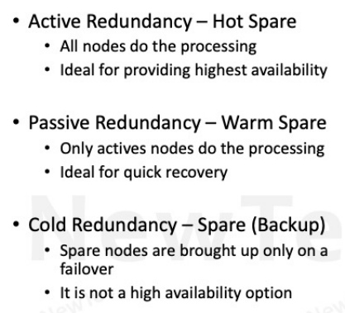
Types of Redundancy

Slide 13
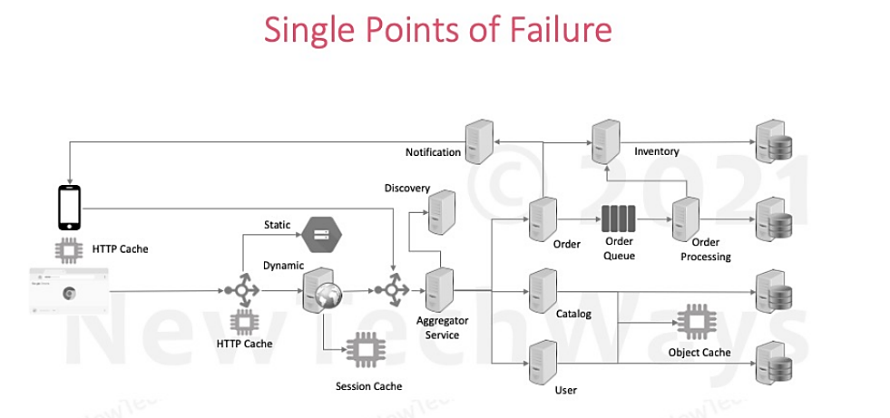

Slide 14
HAVE A GOOD DAY !

